Slide 1
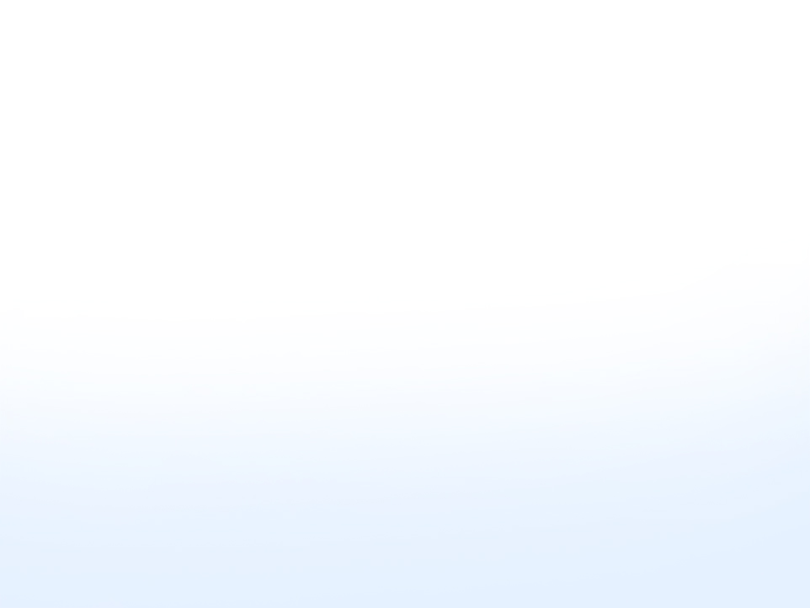
A Quick Way to Spot and Fix Operational Inefficiencies

Slide 2
What's the goal in business?
REDUCE
the failure rate
INCREASE
the success rate

Slide 3
How?
Improve operational efficiency
Maximize profit
Constant improvements in everyday systems
Wide diversity of knowledge in all core functions to be successful

Slide 4
Forward-Thinking Systems Approach
Rearview mirror approach – looks backward
What happened?
Front windshield approach looks to the future
What might happen?
What can happen?
What should happen?

Slide 5
Importance of Planning
Regardless of size
Be proactive – Not reactive
Proactive
Plan with specifics
Roadmap to the future
Reactive
React to something that already happened

Slide 6
Accelerated Actions to Maximize Profit
Success is not based on only one factor in a business
Improvements in the entire system
Operating as efficiently as possible
Beating the competition by being better and different
Question: How do you even get started?

Slide 7
SWOT Analysis
Strengths
Weaknesses
Opportunities
Threats
**Every business has something in each category**

Slide 8
SWOT Analysis
Critical self-evaluation of your business
Highlights factors when planning for the future
Identifies where a business is in relation to the competition
Strategic plan emerges

Slide 9

Operational Management

Slide 10
Operational Management
vs.
Effective
Efficient

Slide 11
Effective Operation
Process adequate to accomplish intended purpose or goal
Produces an expected result
We got the job done

Slide 12
Efficient Operation
Performing same or similar task in best possible manner
Which reduces wasted time and effort = increase in net profit
Concentrates on how much effort it takes to produce desired result
Rather than concentrating on results alone

Slide 13
Example
Similar businesses selling essentially same products or providing the same services
Same size workforce
Located in equivalent type facilities
One completely automated with up-to-date equipment, computers, software
Other still operating with older equipment and manual operations

Slide 14
How To Measure Improvements
Improved productivity
Higher profits
Reduction of billing errors
Less workplace accidents
Increase of new customers
Reduction of customer complaints
Whatever is trying to be improved must be measured

Slide 15
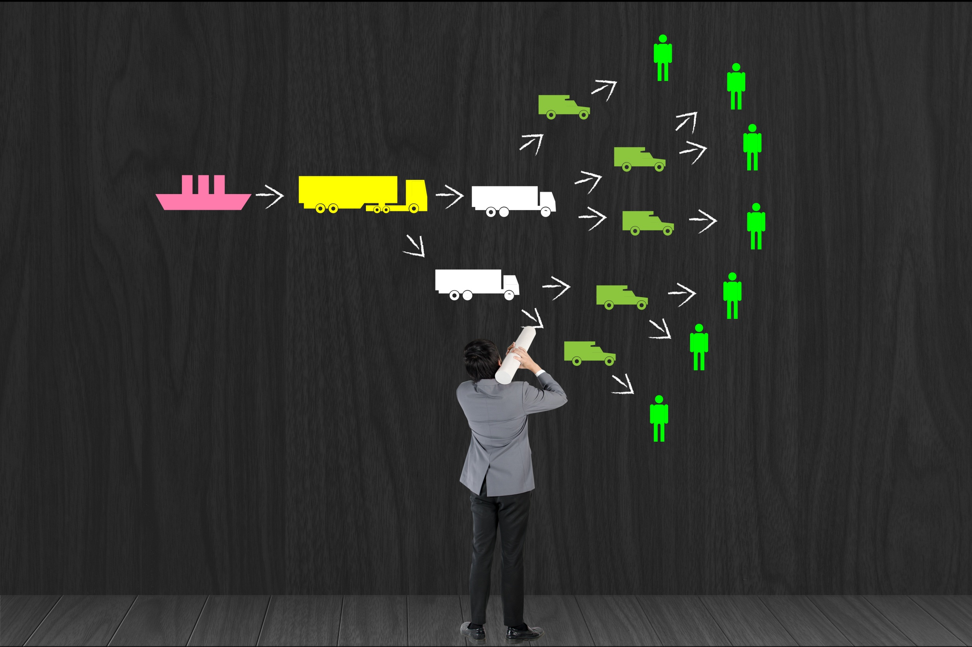
Supply Chain Management (SCM)

Slide 16
Supply Chain Management (SCM)
All primary business activities from beginning of supply movement to final destination
Suppliers
Origin
Customers
Destination

Slide 17
Supply Chain Management (SCM)
SCM reviews all activities, costs, and assets associated with:
(1) Purchasing raw materials and turning those raw materials into work-in-progress that later become inventory, or
(2) Purchasing supplies used in a service business, or
(3) Purchasing finished inventory that will later be assembled and/or prepared for sale to customers

Slide 18
Supply Chain Management (SCM)
Every business has some type of SCM
Regardless of size
Service business
Retail business
Manufacturing business

Slide 19
What Functions of SCM to Review
Forecasting
Purchasing (decisions and contracts)
Production
Scheduling

Slide 20
What Functions of SCM to Review
Inventory (what sells and right amounts)
Transportation
Financing
Special Customer Requests

Slide 21
What Functions of SCM to Review
Forecasting
Anticipate needs
Supplies & inventory coordinated with sales
Purchasing (decisions and contracts)
Pricing, terms, delivery, quality, reliability
Lowest price is not always the best price

Slide 22
What Functions of SCM to Review
Production
Idle time is costly
Supplies must be sufficient...neither overstocked or understocked
Scheduling
Timing is critical
Supplies, materials, inventory all reach business at same intended time
Pieces of a puzzle all fitting together

Slide 23
What Functions of SCM to Review
Inventory
Right inventory (what sells) and sufficient inventory (correct amounts)
Oversupply and undersupply affects net profit
Transportation
Type of transportation
Cost – who pays? Vendor or customer?
FOB origin/shipping point – buyer pays
FOB destination – vendor/seller pays

Slide 24
What Functions of SCM to Review
Financing
Review pricing and terms
Which is most advantageous
Vendor financing vs. traditional lenders
Is the cost of money factored into selling price?

Slide 25
What Functions of SCM to Review
Special customer requests
Consider possible interruption of normal supply chain and operations
Possible effect on net profit
Special requests cannot be counterproductive to normal business activities

Slide 26
Efficient SCM System
Positive effect of efficient SCM system is more than just cost savings
No idle downtime
Goods or services available for customers
Goods or services delivered on time
Customer satisfaction increases leading to long-term relationships

Slide 27
Profit Increases Not Only Through Cost Savings
No idle downtime
Goods available for customers
Goods delivered on time
Customer satisfaction increases leading to long-term relationships!

Slide 28
Summary of Efficient Supply Chain Management System
Improves operations
Achieves customer satisfaction!
Lowers costs
Reduces wasted time and effort

Slide 29
Managing for Change

Slide 30
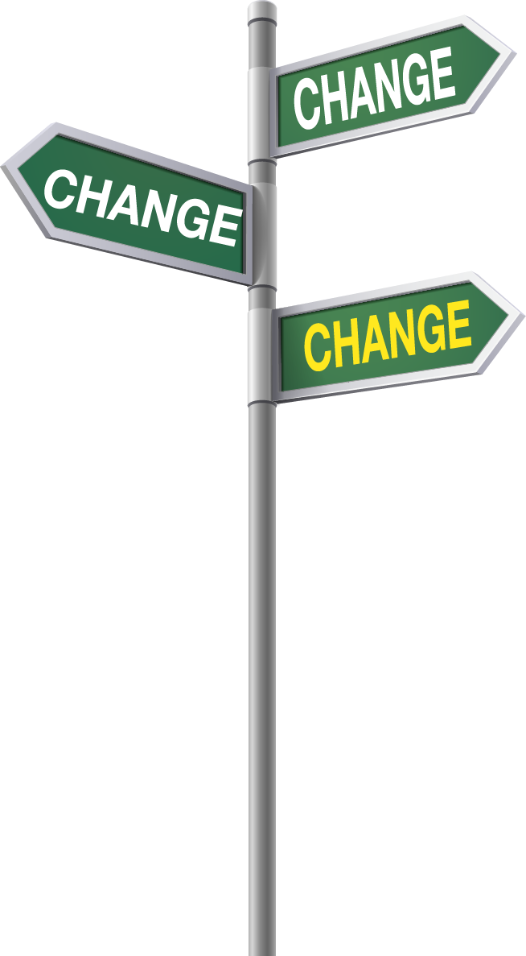
Managing Change
One constant in business is change (not an option)
Businesses must embrace change rather than resist change (change is not going away)
Plan for orderly change

Slide 31
What Causes Change?
Internal factors:
Seek cost savings
Improve product or service quality
Reduce work hours
Have less employee stress
Improve internal security
Standardize workflow

Slide 32
What Causes Change?
External factors:
Customer desires and needs change
Industry changes
Competition
Economic factors
New laws or regulations
Pressure from investors for improved profits

Slide 33
Current Example of External Factor
Amazon effect
The way consumers shop
Online vs. retail
Competitive pricing
Demand for additional services
Change in return policies

Slide 34
Plan for Change
What changes will have the least amount of business interruption?
What changes will provide maximum efficiency?
What is the best time to implement the changes?

Slide 35

Propel Your Small Business to Success
SUCCESS
Go from Stagnation to Elevation!
Knowledge is the Key!

Slide 36

Insert Name

